Slide 1
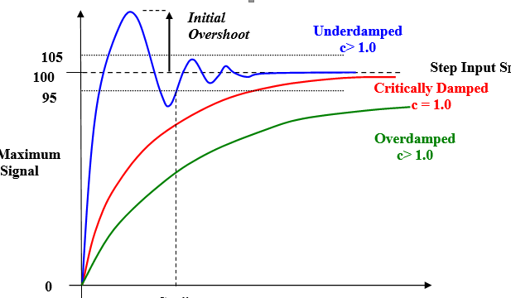
EG431D Data Acquisition
Time Domain Analysis

Slide 2
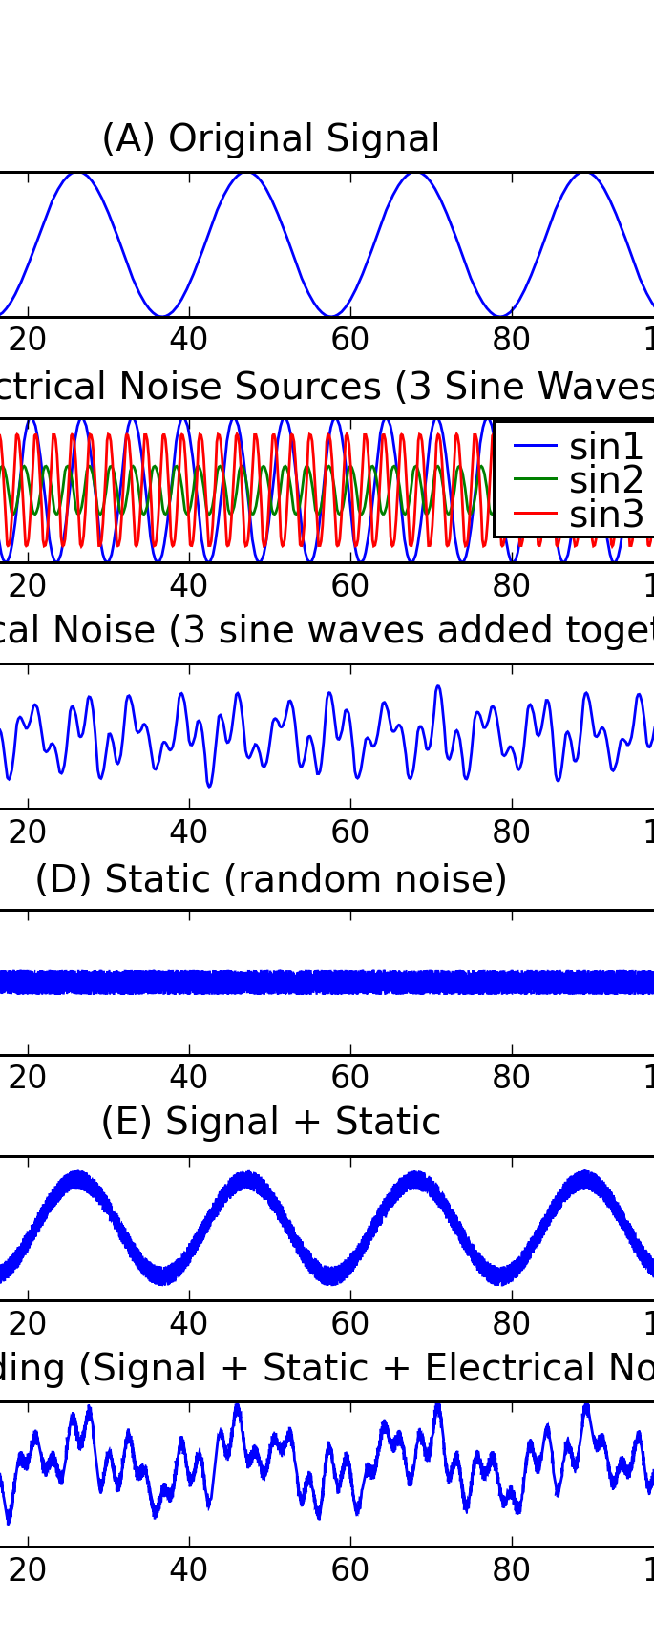
Objectives
Main Goal: Analyze signals in the time domain focusing on key attributes like amplitude, phase, and duration.
Key Objectives:
Describe the process of analyzing signals in the time domain, focusing on key attributes such as amplitude, phase, and duration, and their relevance in practical signal processing applications.
Explain the fundamental rules of time domain analysis, including key concepts like periodicity, time shifts, and convolution, and how they are applied to understand the behavior of signals in real-world systems.
Demonstrate how to apply time domain analysis techniques, such as calculating mean, variance, and autocorrelation, to characterize signals and extract useful information for problem-solving in signal processing.

Slide 3

Introduction to Time Domain Analysis
Definition: Examining signal/system response over time.
Importance:
Insight into transient behaviors and steady-state conditions.
Essential for dynamic systems.
Signal Types:
Continuous (x(t))
Discrete (x[n])
Applications: Monitoring and analyzing real-world phenomena.

Slide 4
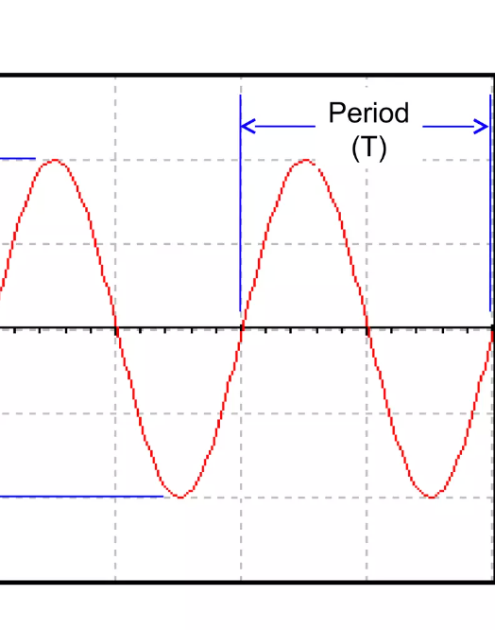
Signal Attributes
Amplitude: Signal’s strength at a given moment.
Duration: Time span of signal existence.
Waveform Shape: Sinusoidal, square, etc.
Key Metrics:
Period: Time for one cycle of a periodic signal.
Rise/Fall Time: Transition speed (10%-90% amplitude).
Zero-Crossing Rate: High-frequency content indicator.

Slide 5
Signal Attributes
Time Interval, Settling Time, Transient, Phase Information, Skewness, Symmetry, Signal Envelope, Signal Energy, Mean, RMS, Crest Factor, Std Deviation, Signal Variance, Kurtosis.

Slide 6

Arduino Applications in Time Domain Analysis
Overview: Cost-effective, versatile, real-time analysis.
Signal Acquisition:
Use of ADCs, sensors.
Precise timing with millis() or micros().
Examples:
Sound Signal Analysis: RMS value.
Temperature Metrics: Max, min, daily average.
Vibration Analysis: Accelerometer data.
Event Counting: Motion events.

Slide 7

Example - Safe Viewing Distance Module
Functionality: Monitors user distance from TV using ultrasonic sensors.
Modes:
Safe Mode: Distance >= 2.2m (no alert).
Reminder Mode: 1.5m ≤ Distance < 2.2m (beeping).
Warning Mode: Distance < 1.5m (intense beeping + TV off).
Technology: Finite State Machine (FSM) for precise state transitions.

Slide 8
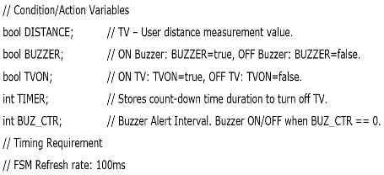
Example - Safe Viewing Distance Module

Slide 9
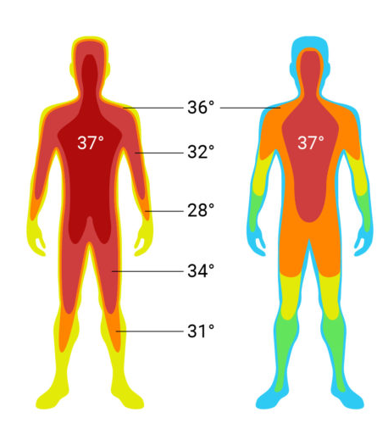
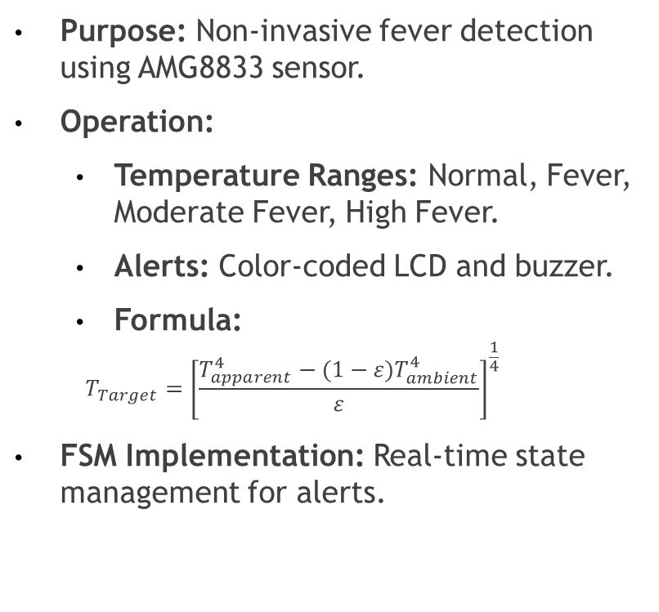
Example - Core Body Temperature Monitor
Purpose: Non-invasive fever detection using AMG8833 sensor.
Operation:
Temperature Ranges: Normal, Fever, Moderate Fever, High Fever.
Alerts: Color-coded LCD and buzzer.
Formula:
$$T_{Target}={\left[\frac{T_{apparent}^{4}−(1−ε)T_{ambient}^{4}}{ε}\right]}^{\frac{1}{4}}$$
FSM Implementation: Real-time state management for alerts.

Slide 10
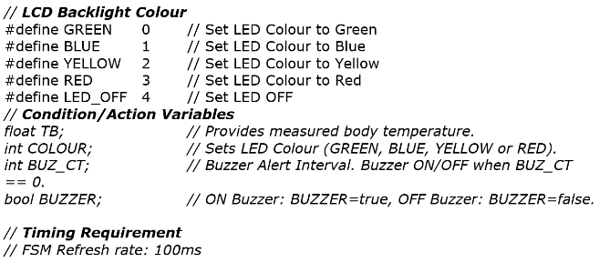
Example - Core Body Temperature Monitor

Slide 11

Comparison with Frequency Domain Analysis
Time Domain Focus: Temporal changes, transient events.
Frequency Domain Focus: Spectral content of signals.
Complementary Techniques: Foundation for Fourier analysis and predictive modeling.

Slide 12

Summary
Advantages: Direct, intuitive, captures temporal changes.
Applications: Essential for real-time monitoring and diagnostics.
Final Note: Building block for advanced signal processing techniques.

